Slide 1
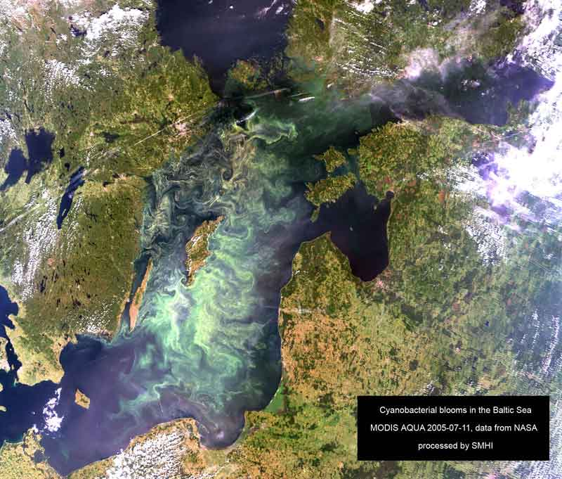
Expanding Bioenergy
– Global Potentials and Regional Challenges
Göran Berndes
Chalmers University of Technology, Sweden
IEA Bioenergy Task 43

Slide 2
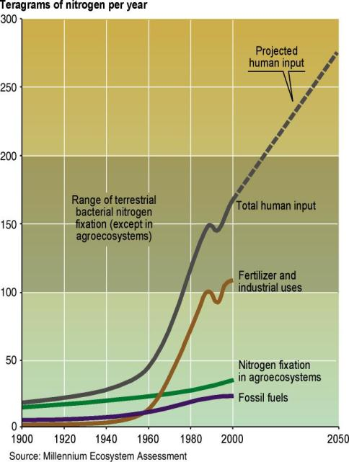
Notes:
Yield potential: the maximum yield a crop can attain, given the field conditions; is determined by CO₂ conc., solar radiation, temperature, plant density
Actual yields: are determined by degree of water and nutrient deficiencies, diseases, pests & weed competition

Slide 3
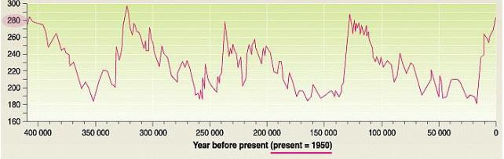
Atmospheric CO₂ concentration
during the past 400 000 years
(from the Vostok Ice Core)
Year 2100 if business as usual
Today ~392 ppm

Slide 4
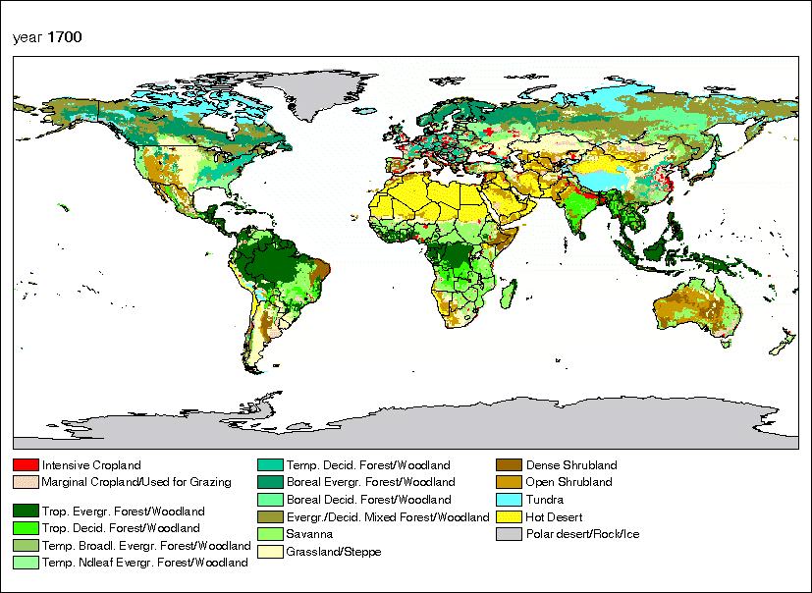
Source: Klein Goldewijk, RIVM, The Netherlands

Slide 5
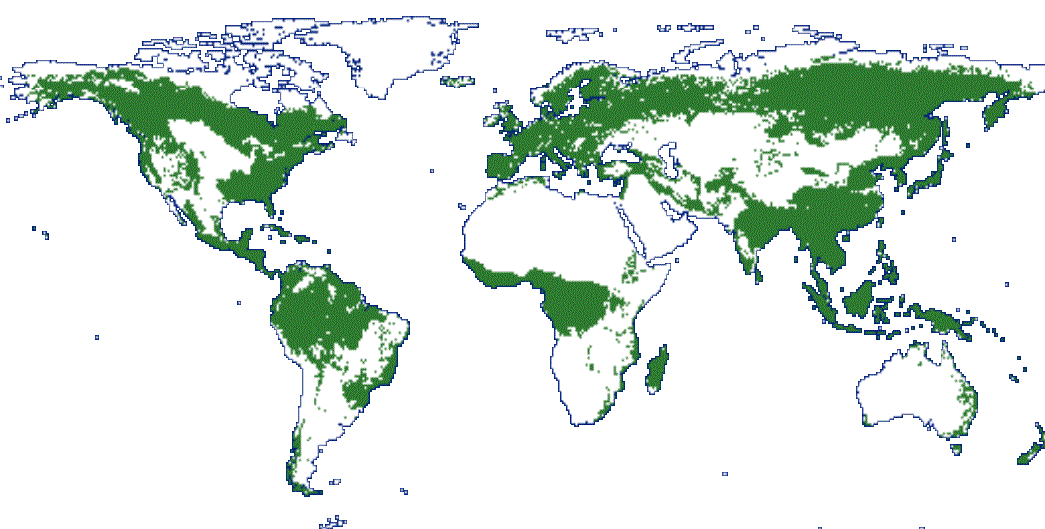
Frontier forests 8000 years ago

Slide 6
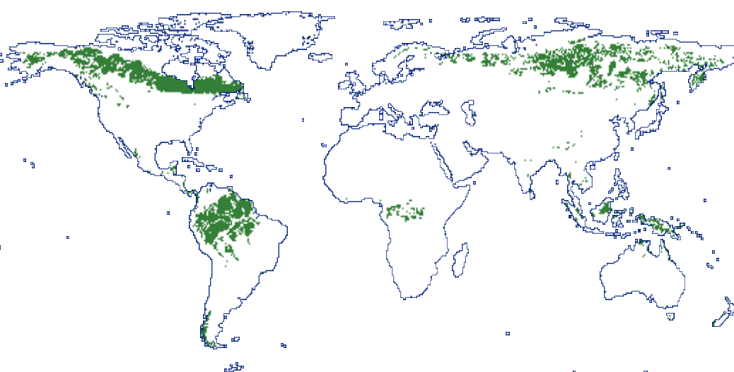
Frontier forests today

Slide 7
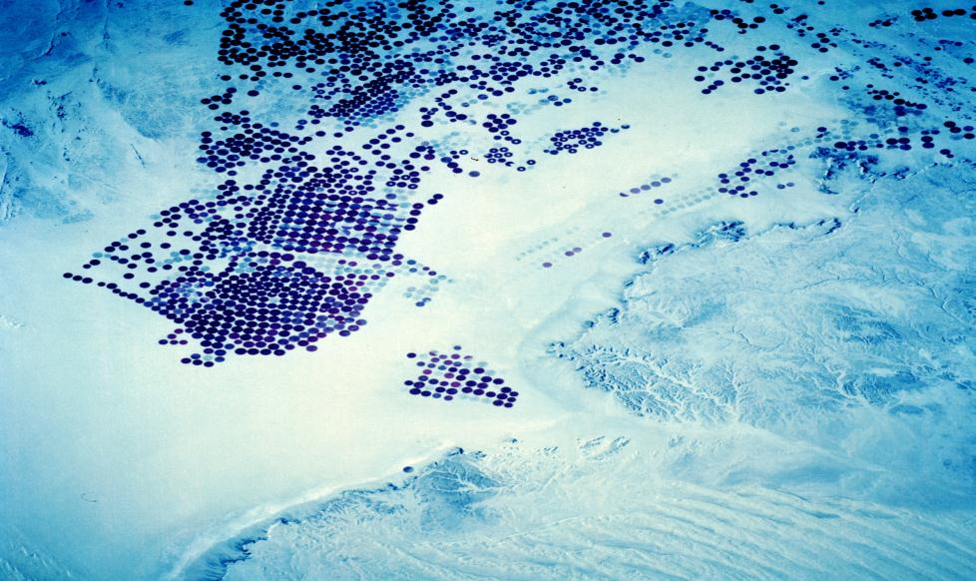
Irrigated cereal production, Saudi Arabia
Notes:
Yield potential: the maximum yield a crop can attain, given the field conditions; is determined by CO₂ conc., solar radiation, temperature, plant density
Actual yields: are determined by degree of water and nutrient deficiencies, diseases, pests & weed competition

Slide 8
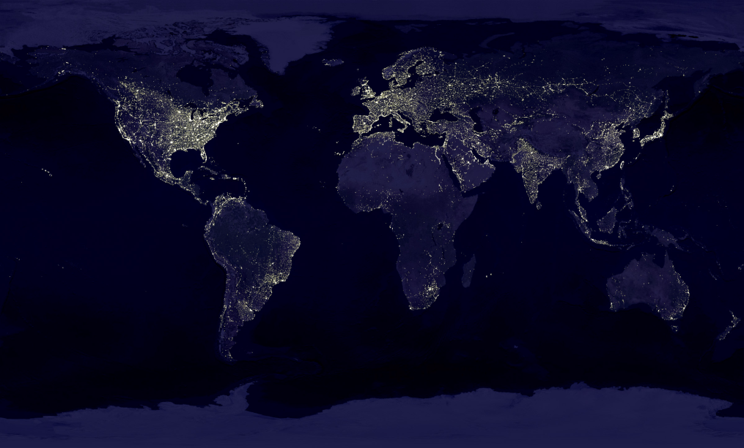
Bioenergy in the Anthroposcene

Slide 9
Bioenergy in the Anthroposcene
Food
Source: FAO

Slide 10
Bioenergy in the Anthroposcene
Food
2050
Food
Source: FAO

Slide 11
Bioenergy in the Anthroposcene
Food
2050
Bioenergy
2050
(deployment at 440-600 ppm)
Food
Sources: FAO & IPCC SREN

Slide 12
Bioenergy in the Anthroposcene
Bioenergy
2050
(deployment at <440 ppm)
Food
2050
Bioenergy
2050
(deployment at 440-600 ppm)
Food
Sources: FAO & IPCC SREN

Slide 13
Bioenergy in the Anthroposcene
Bioenergy
2050
(deployment at <440 ppm)
Food
2050
Bioenergy
2050
(deployment at 440-600 ppm)
Food
Global industrial roundwood
Sources: FAO & IPCC SREN

Slide 14

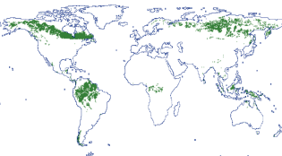
To-do…
Produce more food on a smaller area and with lower impacts
Increase biomass output from forestry while keeping the forests healthy and respecting biodiversity requirements
Expand bioenergy production in ways that are acceptable from the perspectives of resources, environment, and socio-economy

Slide 15
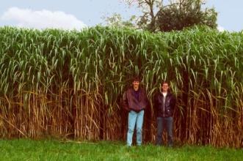
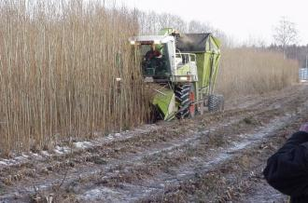
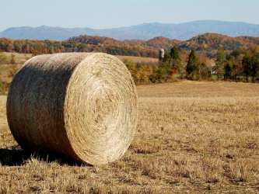
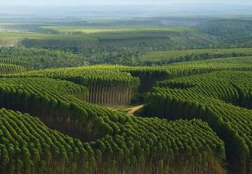
Room for bioenergy plantations?

Slide 16
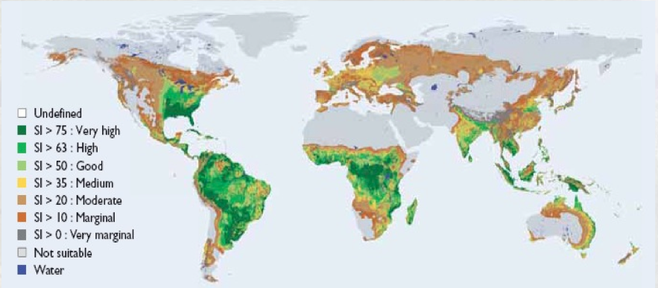
Biophysical assessments indicate considerable bioenergy supply potentials
Land suitability for herbaceous and woody lignocellulosic plants (Fischer et al 2009)

Slide 17
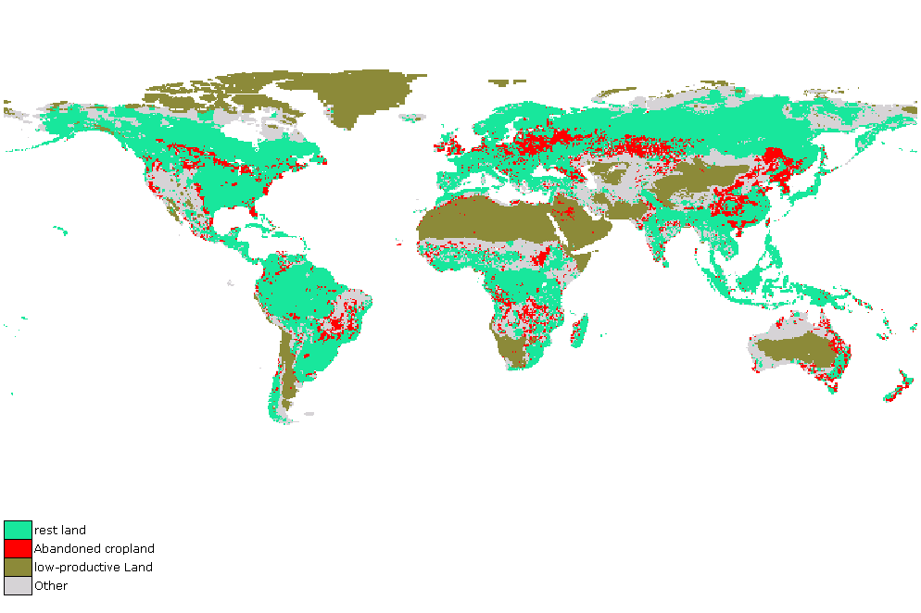
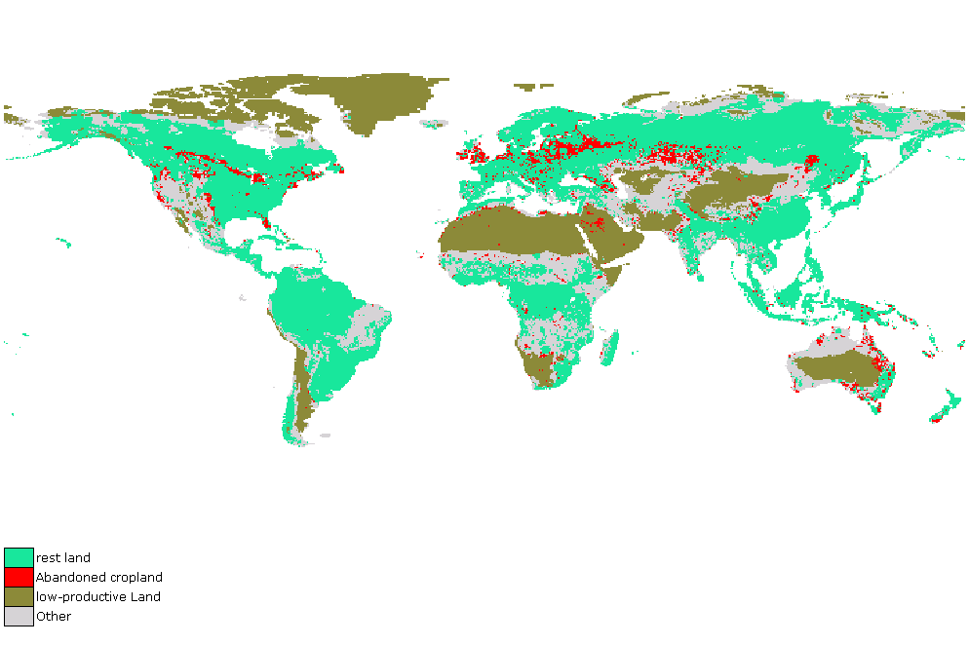
…but requires high agriculture productivity growth (and it helps if we eat less meet)
Illustrative example study: land availability for energy crops (Hoogwijk et al. 2005)
A1: 2050
A2: 2050
Notes:
Yield potential: the maximum yield a crop can attain, given the field conditions; is determined by CO₂ conc., solar radiation, temperature, plant density
Actual yields: are determined by degree of water and nutrient deficiencies, diseases, pests & weed competition

Slide 18
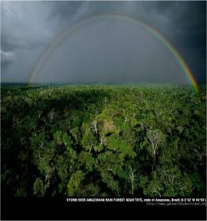

…and bioenergy expansion needs to be guided in attractive directions
CO₂
CO₂
Crop growth
Biofuel production and use
Large C stock and lots of biodiversity
Closed loop
Smaller C stock and less biodiversity
Dense forest
Bioenergy plantation: Annual CO₂ savings much lower than the CO₂ emissions from forest conversion

Slide 19
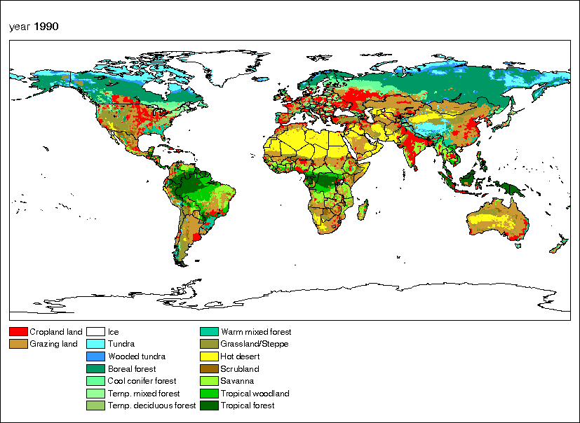
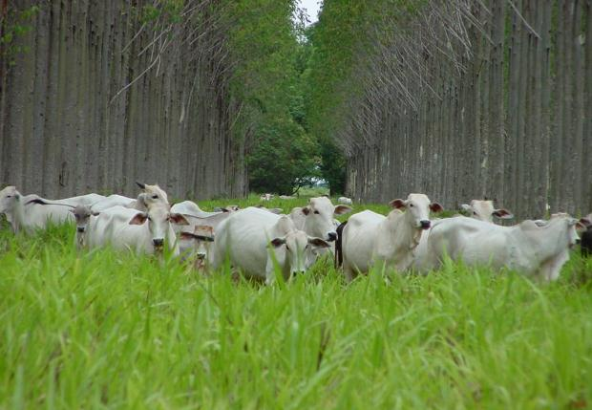
Regional challenges and possibilities
Notes:
Integrated bioenergy-food systems may increase water productivity

Slide 20
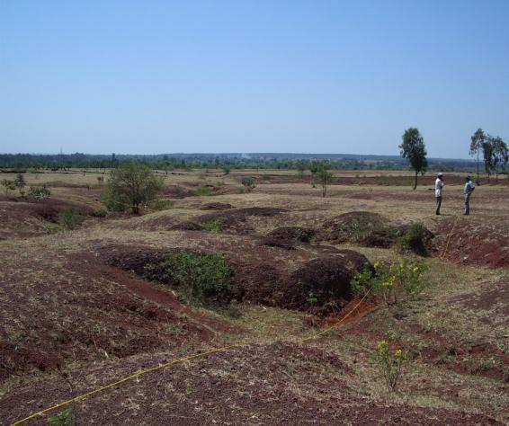
Regional challenges and possibilities
Notes:
Almost 20% of the total land area in India is classified as wasteland and includes grassland, degraded forestland, gullied, ravenous and bedrock intruded land, land under shifting cultivation, degraded pasture and grazing land, degraded land under plantation and mining and industrial land.

Slide 21
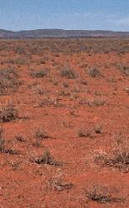
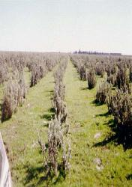
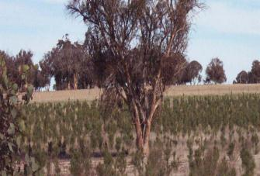
Regional challenges and possibilities
Notes:
Tracts of land where natural vegetation grows in abundance have always been regarded as choice sites for agriculture. If the natural vegetation is lush, so the reasoning goes, then agriculture should also be highly productive. Unfortunately, this is not always the case; clearing can have unforeseen and often damaging effects on the soils and hydrology of a region. For a start, removal of natural vegetation exposes the land to the powerful forces of wind and water; the net effect can be serious erosion and a general degradation of the soil. In addition, since crops rarely use as much water as the vegetation they displace, land clearing can lead to a rise in the water table. The ensuing waterlogging and soil salinisation can spell disaster for farming.
In the last few decades, farmers have sought solutions to such problems. Naturally, perhaps, the concept of returning trees to the landscape is at the forefront of many attempts to rehabilitate degraded land.
The potential benefits are many: tree plantations can stabilise soil while offering shelter to crops and livestock. They can help lower water tables by reducing groundwater recharge and increasing discharge. They can provide habitat for native species of flora and fauna. They can produce timber for sale or use around the farm; in some cases they can even provide animals with an additional source of feed in times of drought.
Today, alley farming is practised in the south-west of Western Australia (about 10,000 hectares), south-eastern South Australia (several hundred hectares), the mallee and Wimmera of Victoria (less than 100 hectares) and in south-eastern Queensland (less than 100 hectares). Some 5,000 hectares of this has been planted specifically to control rising water tables in the wheatbelt of Western Australia, while the rest are multipurpose plantings for fodder, timber, wind protection and soil improvement.

Slide 22
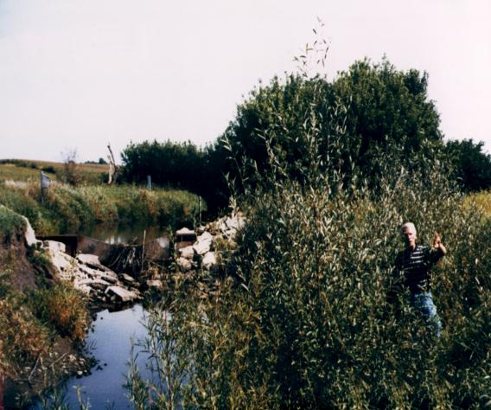
Regional challenges and possibilities

Slide 23
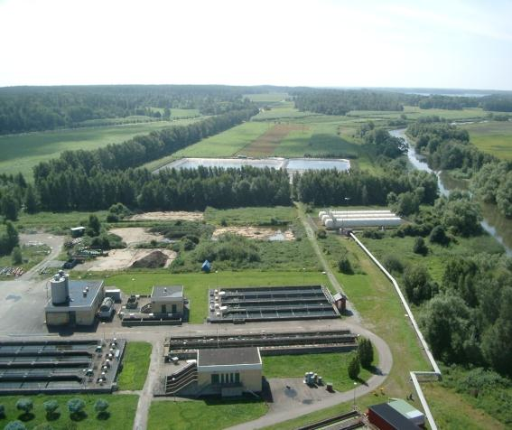
Regional challenges and possibilities

Slide 24
THANK YOU!

Slide 26
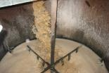
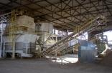
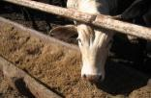
Bioenergy-food integration…
Traditional cattle
Integrated cattle sugarcane farm
Ethanol
20 %
Forest reserve
20 %
Forest reserve
Sugarcane
Winter restricts productivity
20 ha
20 cows (13 in milk prod.)
4.5 L/day
Sugarcane
50%
Pasture
(summer)
30%
Winter feed
Pasture
80%
Integration of sugarcane ethanol production with livestock production
  Stimulates livestock productivity increase, creating space for cane
  Large local socioeconomic benefits and reduced risk of displacement

Slide 27
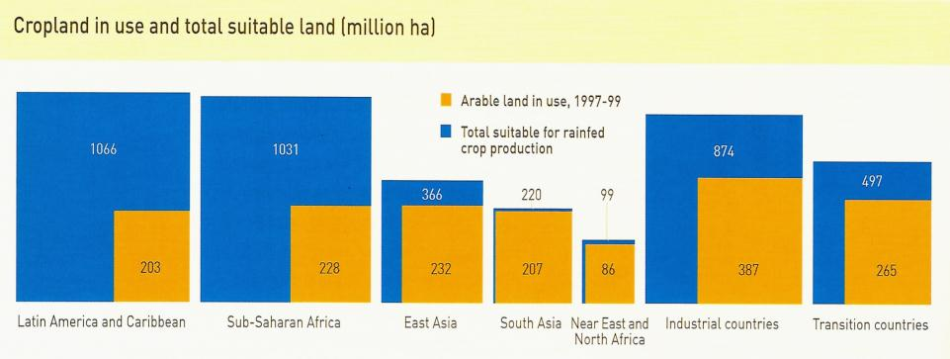
Bioenergy Potentials: the supply side (part 1)
Most of the potential for expanding cropland area is concentrated in Latin America and Sub-Saharan Africa.
Much of the area is presently covered by forests and other natural ecosystems and has more or less serious climate/soil constraints
Cropland around year 2000
Total suitable for rain-fed crop production
Land suitability for cellulosic crop production (Fischer et al 2009)

Slide 28

Expanding bioenergy : challenges
Establishment of bioenergy plantations can also lead to that CO₂ is assimilated into soils and biomass, enhancing the GHG savings. Wisely located, designed and managed plantations can also provide additional environmental services, including be beneficial for biodiversity
CO₂
CO₂
Crop growth
Biofuel production and use
Closed loop
Small C stock
Larger C stock
Degraded pasture
Bioenergy plantation: CO₂ assimilation in growing plantation enhances CO₂ benefits

Slide 29
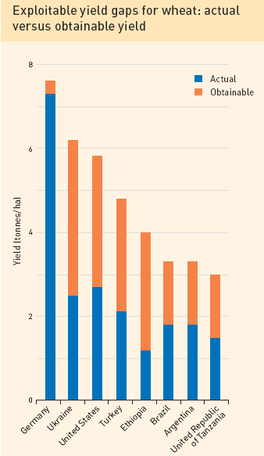
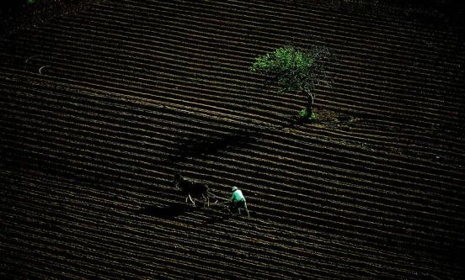
Bioenergy Potentials: the supply side (part 2)
There are significant yield gaps to exploit so potential for improving yield levels in many places
Notes:
Yield potential: the maximum yield a crop can attain, given the field conditions; is determined by CO₂ conc., solar radiation, temperature, plant density
Actual yields: are determined by degree of water and nutrient deficiencies, diseases, pests & weed competition

Slide 30
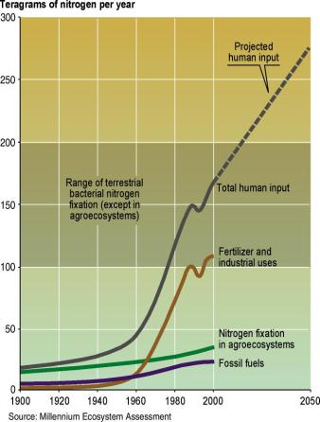
Expanding bioenergy : challenges
But the intensification requires increased inputs of e.g., N
Notes:
Yield potential: the maximum yield a crop can attain, given the field conditions; is determined by CO₂ conc., solar radiation, temperature, plant density
Actual yields: are determined by degree of water and nutrient deficiencies, diseases, pests & weed competition

Slide 31
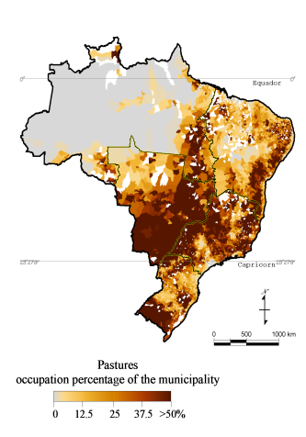
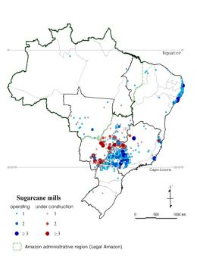
Bioenergy-food integration…
Pastures = 25 x sugarcane area
Notes:
Water impacts of bioenergy production on pastures?

Slide 32

Bioenergy-food integration…
Traditional cattle
Integrated cattle sugarcane farm
Ethanol
20 %
Forest reserve
20 %
Forest reserve
Sugarcane
Winter restricts productivity
20 ha
20 cows (13 in milk prod.)
4.5 L/day
Sugarcane
50%
Pasture
(summer)
30%
Winter feed
Pasture
80%
Integration of sugarcane ethanol production with livestock production
  Stimulates livestock productivity increase, creating space for cane
  Large local socioeconomic benefits and reduced risk of displacement

Slide 33
Water implications of bioenergy
Pastures = 25 x sugarcane area

Slide 34
Water implications of bioenergy

Slide 35
Role of bioenergy in strategies to…
Increase productive use of blue/green water flows
improve water productivity in agriculture

Slide 36
Role of bioenergy in strategies to…
Increase productive use of blue/green water flows
improve water productivity in agriculture

Slide 37

Historic land use change
Source: Klein Goldewijk, RIVM, The Netherlands

Slide 38
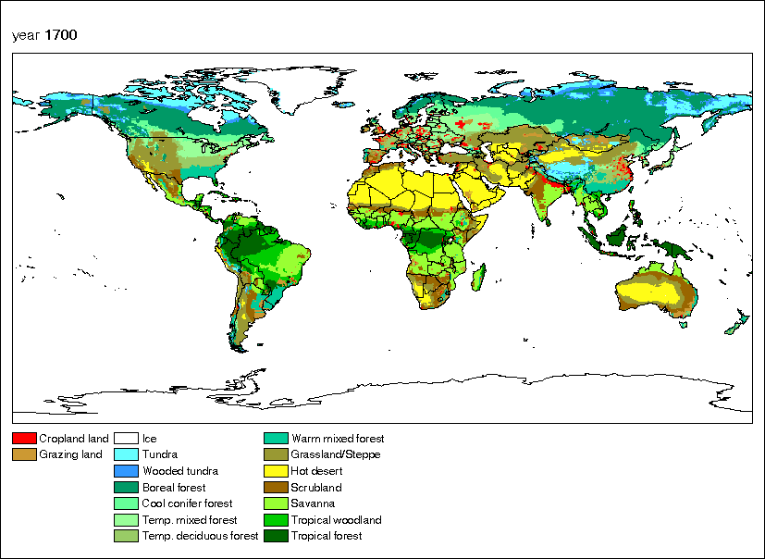
Historic land use change
Year 1700
Present situation (roughly)
300-400 Mha cropland
ca 1600 Mha cropland
400-500 Mha pastures
ca 3200 Mha pastures
Source: Klein Goldewijk, RIVM, The Netherlands

Slide 39
LUC emissions...

Slide 40
GHG benefits of expanding bioenergy?
Source: Berndes 2006

Slide 41
Reports available for download:
- www.ieabioenergy.com
- www.ipcc.ch

