Slide 1
IEA Bioenergy Briefing to the REWP
29 March 2018
Jim Spaeth
Chair IEA Bioenergy Executive Committee

Slide 2
IEA Bioenergy TCP
Mission:
To increase knowledge and understanding of bioenergy systems in order to facilitate the deployment of:
environmentally sound
socially acceptable and
cost-competitive bioenergy systems
Key Role:
Independent collaborative body focused on delivering clear and verified information on bioenergy

Slide 3
Membership - 24 Contracting Parties
ASIA/OCEANIA/AFRICA
  Australia
  Japan
  Korea
  New Zealand
  South Africa
EUROPE:
  Austria
  Belgium
  Croatia
  Denmark
  European Commission
  Estonia
  Finland
  France
  Germany
  Ireland
  Italy
  Netherlands
  Norway
  Sweden
  Switzerland
  United Kingdom
AMERICA’S
  Brazil
  Canada
  United States
In discussions:
China
India
Mexico
2018 Budget: US$1.8 Million
Tasks: 10 + 6
Task participation: 98
Direct participation:
> 200 persons

Slide 4
IEA Bioenergy – Depth and Breadth
Sources
Task 43 Feedstocks & socio-economics
Task 36 MSW
Task 37 Biogas
Task 39 Liquid biofuels
Task 32 Combus-tion
Task 33 Gasifica-tion
Task 34 Lique-faction
Processes
Products
Task 42 Biorefining
Horizontal
/ systems
Task 38 Sustainability
Task 40 International markets & trade
Task 41 Systems analysis

Slide 5
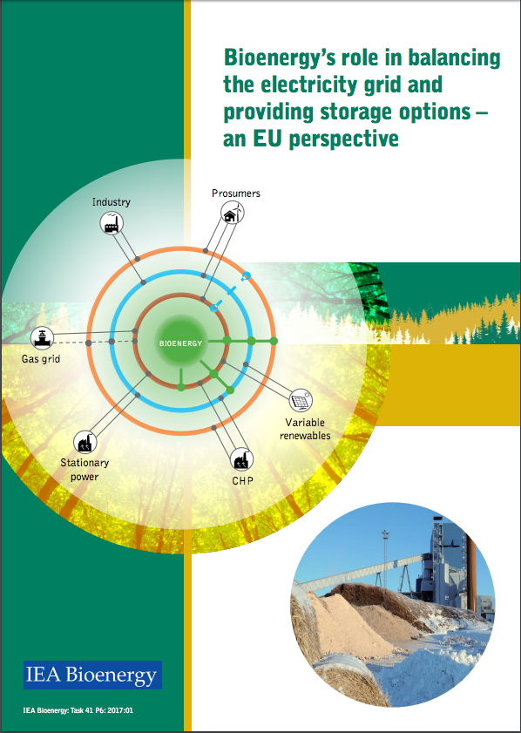
Special projects (Task 41)
Bio-CCS and Bio-CCUS
Bioenergy - Balancing the Grid and providing Storage Options
Bioenergy - Renewable Energy System Hybrids
Contribution to IEA Technology Roadmap on Bioenergy

Slide 6

2017 Publications
Integrated Bioenergy Hybrids – Flexible renewable energy solutions
Global wood pellet industry and trade study 2017
Biofuels for the marine shipping sector
Methane emissions from biogas plants
Aerosols from Biomass Combustion
Bioenergy’s role in balancing the electricity grid and providing storage options – an EU perspective
State of Technology Review – Algae Bioenergy
The Potential of Biofuels in China
Others – see http://www.ieabioenergy.com/iea-publications/

Slide 7

Communications
Cooperation with other international organizations:
  IRENA, FAO, GBEP, BioFutures Platform, Mission Innovation, SEforAll/Below50
Position papers
  ‘Bioenergy for Sustainable Development’
  Chatham House Report Response
Bi-Monthly Webinars
Workshop Reports
Success Stories
Summaries of Technical Reports
Twitter (@IEABioenergy)
www.ieabioenergy.com

Slide 8



Bioenergy for Sustainable Development
Options for sustainable bioenergy expansion
  Multiple-functional land use
  Sustainable intensification, landscape planning, forest management
    with better information and digitalisation
  Restoring degraded or marginal lands
  Using waste and organic residues
  Reducing losses in the food chain
Bioenergy is part of a larger bioeconomy.
  Biorefineries: integrated production systems
http://www.ieabioenergy.com/publications/bioenergy-for-sustainable-development/

Slide 9
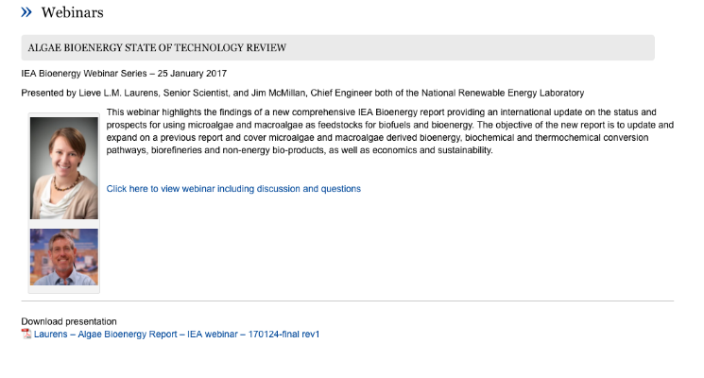
Webinars
Aerosols from Biomass Combustion, 22-Mar-18
The IEA Bioenergy Roadmap: Delivering Sustainable Bioenergy, 21-Feb-18
Methane emissions from biogas plants – Methods for measurement, results and effect on greenhouse gas balance of electricity produced, 18-Jan-18
The Hotspots of the Global Wood Pellet Industry and Trade 2017, 1-Dec-17
Integrated Bioenergy Hybrids – Flexible Renewable Energy Solutions, 14-Sep-17
Others – see http://www.ieabioenergy.com/iea-publications/webinars/

Slide 10
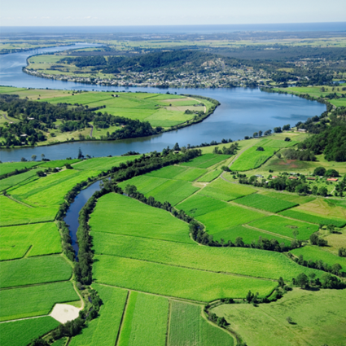
BIO-CCS AND BIO-CCU Workshop, Brussels
Recent and Upcoming Events
January 16, 2018
Task 43 Workshops Upcoming
The Nordic Forest Model
Attractive Systems for Bioenergy Feedstock Production
Governing sustainability of bioenergy, biomaterial and bioproduct supply chains
International Conference on Negative CO₂ Emissions
Chalmers University, Gothenburg, Sweden
May 22-24, 2018
Next IEA Bioenergy ExCo Meeting
Ottawa, Canada, May 29 – June 1, 2018

Slide 11
Preparations for Next Triennium - 2019-2021
Surveys
  To stakeholders: on-line, received 358 replies
  To ExCo members and Task leaders
In 2018, need to decide on
  Current Tasks, new Tasks or Intertask projects or special projects
    Likely additions
      New Task on Integrating bioenergy and other renewable energy forms, BioCCU/S
    Intertask work on
      Sustainability governance, techno-economics, acceptance/socio-economic impacts, …

Slide 12



End of Triennium Event 2018
San Francisco, November 5-9, 2018
  Monday - IEA Bioenergy Task Meetings
  Monday/Tuesday - IEA Bioenergy Executive Committee
ABLC Conference Events – November 7-9
  Wednesday - IEA Bioenergy - End of Triennium Program
    Evening International Session with Biofuture Platform, below50, IRENA, …
  Thursday - ABLC Program
  Friday - US DOE Bioenergy Program

Slide 13
State of Industry Updates
International Civil Aviation Organisation (ICAO)
  Global agreement on first regulation of emissions within the sector
Global wood pellet production and consumption grows
Brazil - Created a new national biofuels policy, RenovaBio
China – 10% Ethanol blending by 2020
India – 10% Ethanol planned
Europe
  Clariant to build new plant in Romania
  Enerkem to build in Netherlands
  Silva Green Fuel AS to build in Norway
USA
  POET
  New Plants - Aemetis, Red Rock Biofuels, Fulcum

Slide 14
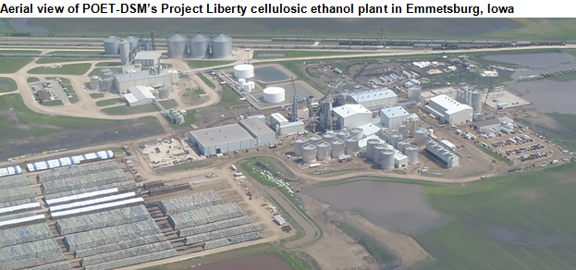
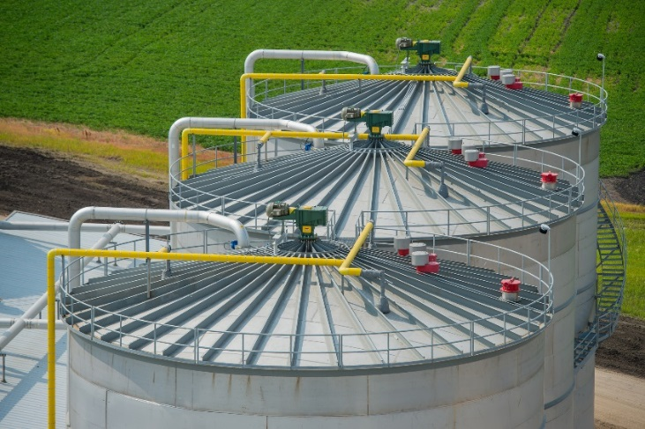
POET-DSM

Slide 15

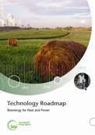






Opportunities for Growth:
Linking Multi-lateral Efforts
below50/WBCSD GBEP RSB IDBs

Slide 16
Conclusions
Bioenergy has an important role to play
  in expanding availability and access to robust and reliable energy systems
  and realising low carbon transportation
IEA Bioenergy continues to provide crucial science based analysis to inform the international community
Methods for disseminating IEA Bioenergy messages are expanding with the use of webinars and social media
Collaboration with relevant international bodies is developing strongly

Slide 17

Thank you for your consideration
Jim.Spaeth@ee.doe.gov
Phone: 01.720.356.1784

Slide 18
Annual Budget: 2018
The currency for the Technology Collaboration Programme is US dollars
Task Funds (10 Tasks) | 1,368,990
Strategic Fund # | 115,210
ExCo Secretariat Fund | 219,000
Technical Coordinator Fund | 77,700
Total | 1,789,000
# the Strategic Fund is a component of the Task Funds.

Slide 19
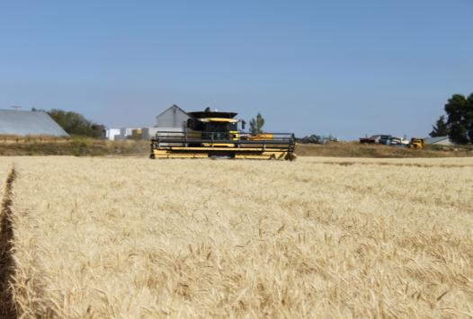
Tasks
Task 32 - Biomass Combustion and Co-firing
Task 33 - Gasification of Biomass and Waste
Task 34 - Direct Thermochemical Liquefaction
Task 36 - Integrating Energy Recovery into Solid Waste Management Systems
Task 37 - Energy from Biogas
Task 38 - Climate Change Effects of Biomass and Bioenergy Systems
Task 39 - Commercialising Conventional and Advanced Liquid Biofuels
Task 40 - Sustainable biomass markets and international bioenergy trade to support the biobased economy
Task 42 - Biorefining in a future BioEconomy
Task 43 - Biomass Feedstocks for Energy Markets

Slide 20
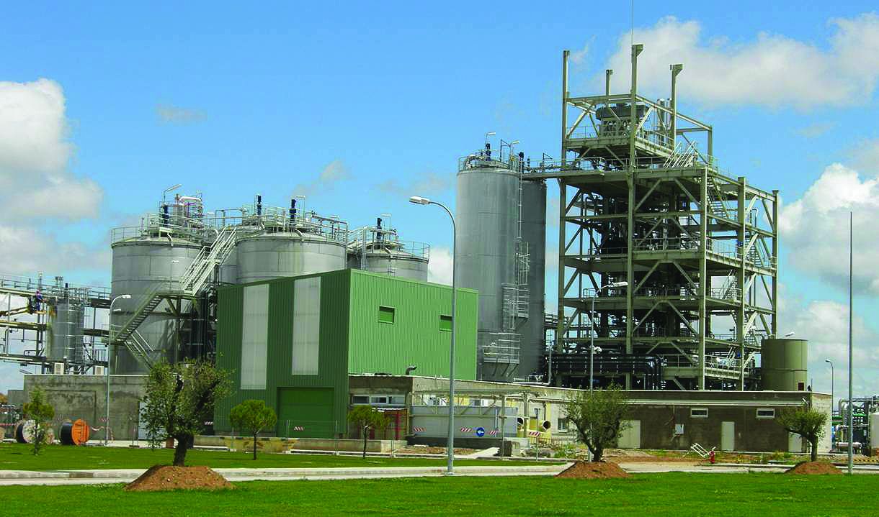
Inter-Task Projects
Fuel pretreatment of biomass residues in the supply chain for thermal conversion
Measuring, governing and gaining support for sustainable bioenergy supply chains
Bioenergy Success Stories

Slide 21
ExCo Meetings for 2015-2018
ExCo | Location | Date
75 | Ireland | May 2015
76 | Germany | October 2015
77 | Italy | May 2016
78 | New Zealand | November 2016
79 | Sweden | May 2017
80 | Switzerland | October 2017
81 | Canada | May-June 2018
82 | USA | November 5-9, 2018

Slide 22
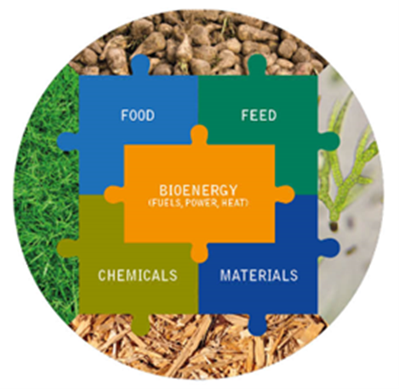
Top Priority Challenges
Sustainability
Biomass resources and mobilisation
Technology deployment / commercial success
Financing
Policy
Communication
Integrated approach !

Slide 23
Areas for Additional Collaboration
Cost reduction strategies for biofuels
Electrofuels
Integration into the energy system with other renewables – ETSAP, Solar, Wind, …
Communication

Slide 24
Collaboration with other TCPs

Slide 25
TCP Benefits
Strengthen national R&D capabilities
Share research costs
Pool technical resources
Avoid duplication and unproductive research paths
Network researchers
Standardise methodologies
Harmonise technical standards
Enhance the quality of R&D outputs
Disseminate information on technology capabilities
Accelerate the deployment of new technologies
Build a common understanding of the technical basis for issues
Contribute to energy policy development

